Slide 1
Ashoka makerspace

Slide 2
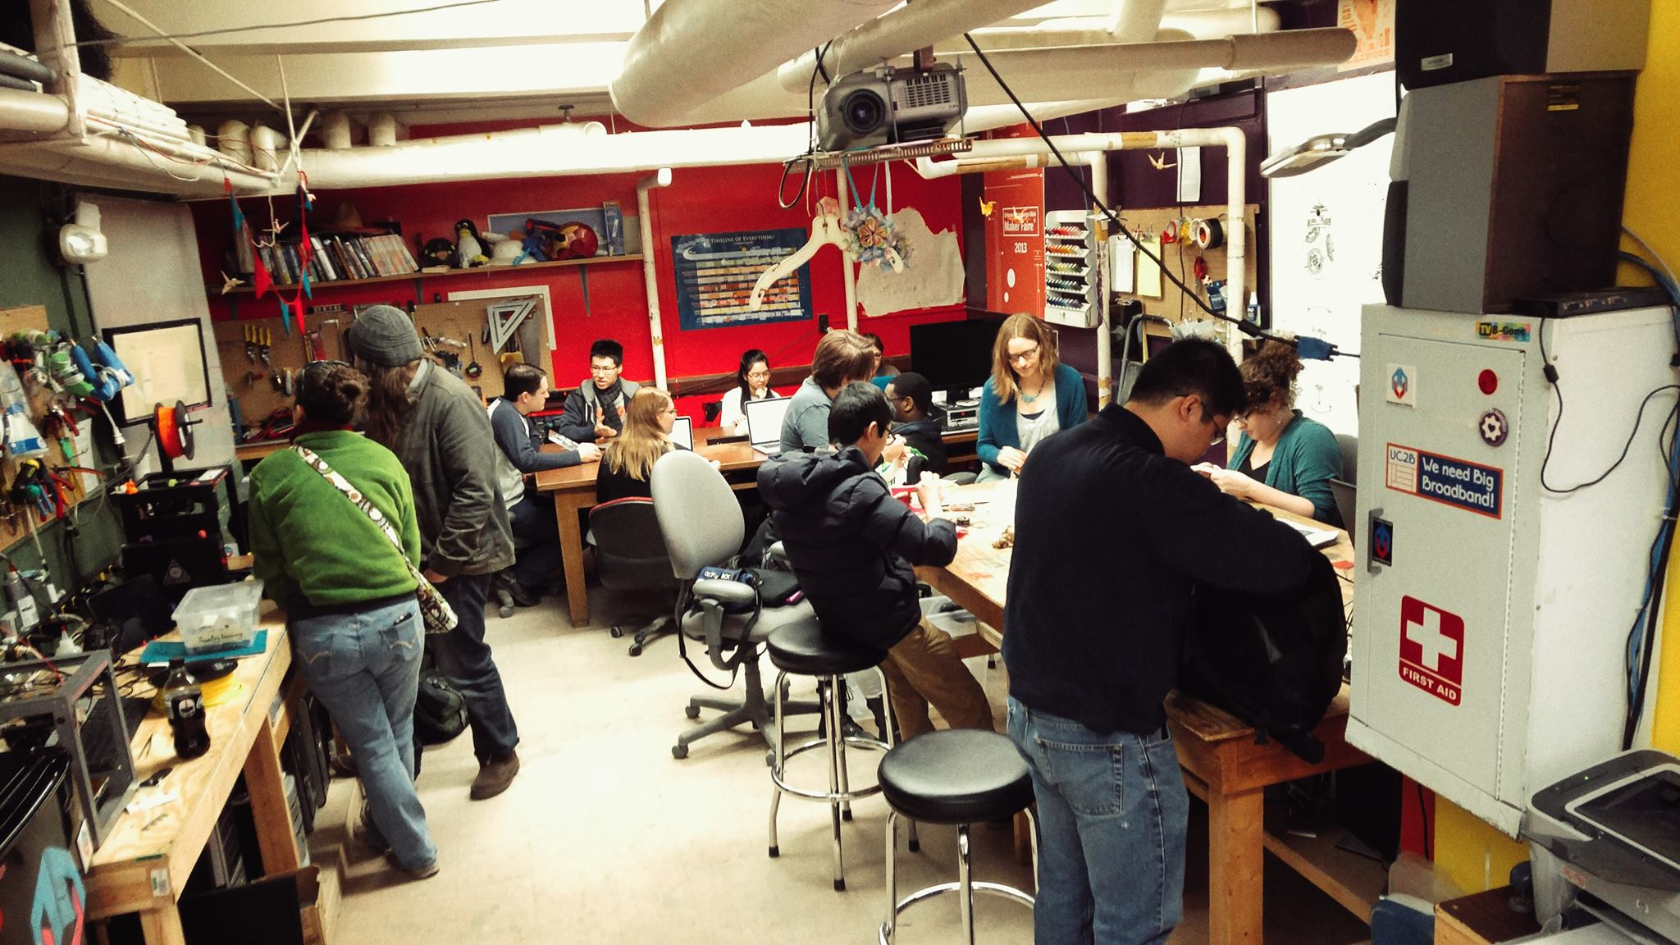
What is a makerspace?
Put simply, a Makerspace is a space where people can come and, well, make things.
The space provides them with the raw materials and tools, and lets them use them according to their needs.

Slide 3
Why at Ashoka?
While Ashoka has several outlets for discussions and sharing literary and performance works, nothing exists for those who like to work with hardware.
With the addition of sciences, many students, especially from the CS and Physics course want to work with electronics and on making things.
It allows students to test out any ideas they may have, giving them an opportunity to make prototypes and refine their idea.

Slide 4
Why at Ashoka? (cont.)
Events could be planned around the space, things like Startup Ashoka could be supplemented by the availability of the makerspace.
A co-curricular could be offered utilizing the space, teaching students more about having a hands-on approach to work.
An example of its use: For Banjaara, we plan to make arcade cabinets, for people to play retro games. Having a Makerspace would provide the perfect space and tools to make such a thing.

Slide 5
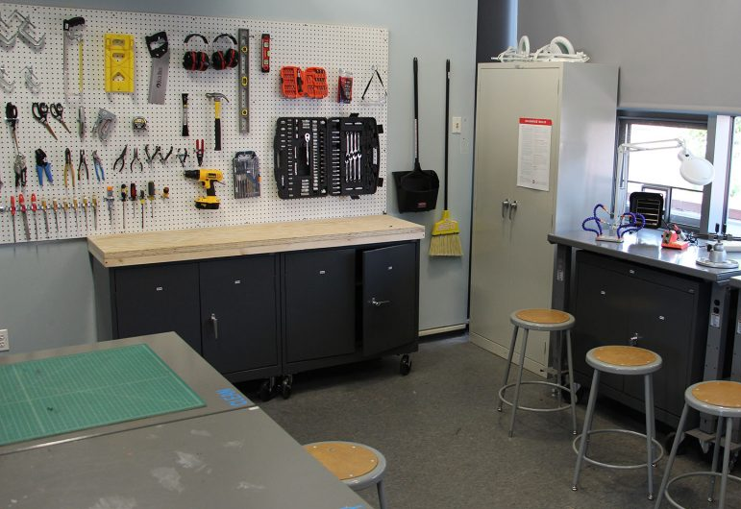
So, what’s needed?
The Makerspace would require a preferably large area, allowing for multiple machines and workbenches to be placed, and possible additions in the future.
Any student wanting to use the space would need to take a quick safety course beforehand.
There would need to be an experienced assistant to prevent injuries, and help students.

Slide 6
So, what’s needed? (cont.)
Ideally the flooring should be tiled, to make it easier to clean, and wooden flooring may catch fire in the case of any accidents.
It would need to be well ventilated, with an area near windows or ventilation for the soldering.
Table and stools would be needed for students to work on, as well as to hold equipment.
Storage for parts, raw materials and tools would be needed. A small budget as well for safety posters and reminders.

Slide 7
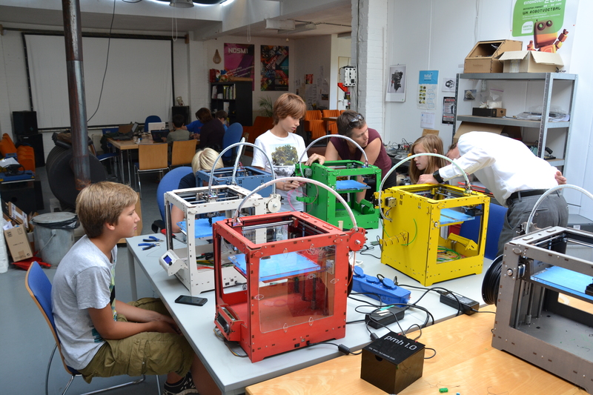
So, what’s needed? (cont.)
The cost of raw materials could be taken from students who use the space, depending on their usage.
If someone is doing some work as part of a class or under a professor/department, they will not be charged.
For the equipment and materials, an Excel sheet has been prepared with costs and some ideal sources/vendors.

Slide 8
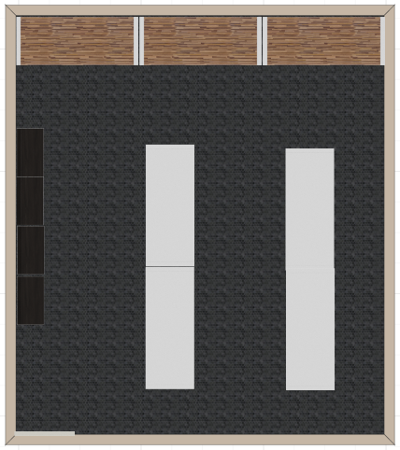
So, what’s needed? (cont.)
To give a rough idea of what the layout could look like:
The basic idea is to have the general work tables in the center of the room.
Tables with the 3D printers, soldering iron and computers would be against a wall, with the soldering iron near a window or ventilation opening.
Along the walls would be the shelves for tools. Ideally the tables should be moveable, in case more space on the ground is needed.

